Slide 1
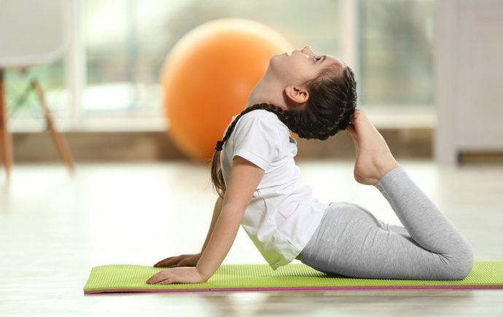
Yoga Parents Pack
Primary Resources

Slide 2
CALMING EXERCISES

Slide 3
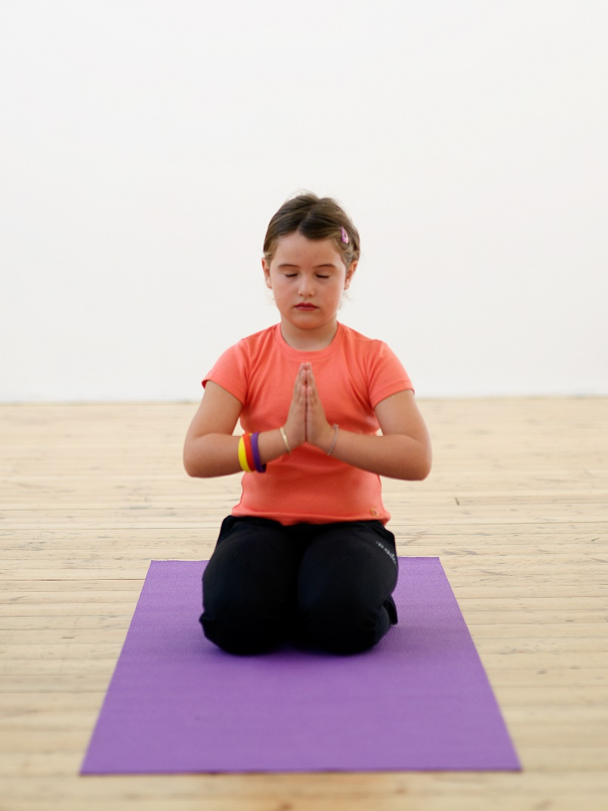
Diamond (Vajrasana)
Start in a kneeling position with your heels close together.
Let your legs become heavy on the mat and your spine awake and straight.
Breathe out and bring your hands together in prayer position.
Take five deep breathes imagining yourself as a brilliant sparkling diamond.

Slide 4
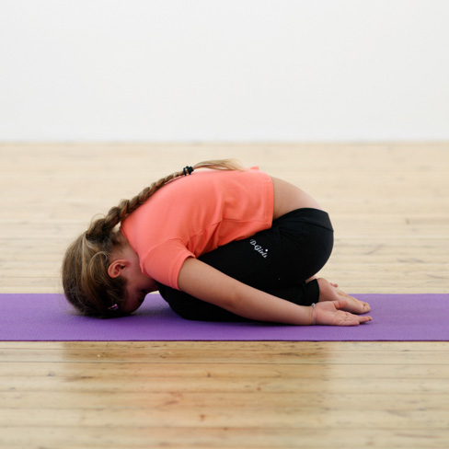
Dormouse / child (Pindasana)
Release your hands and gently fold over your legs with your forehead resting on the ground.
Be quiet and still like a little sleeping Dormouse.

Slide 5
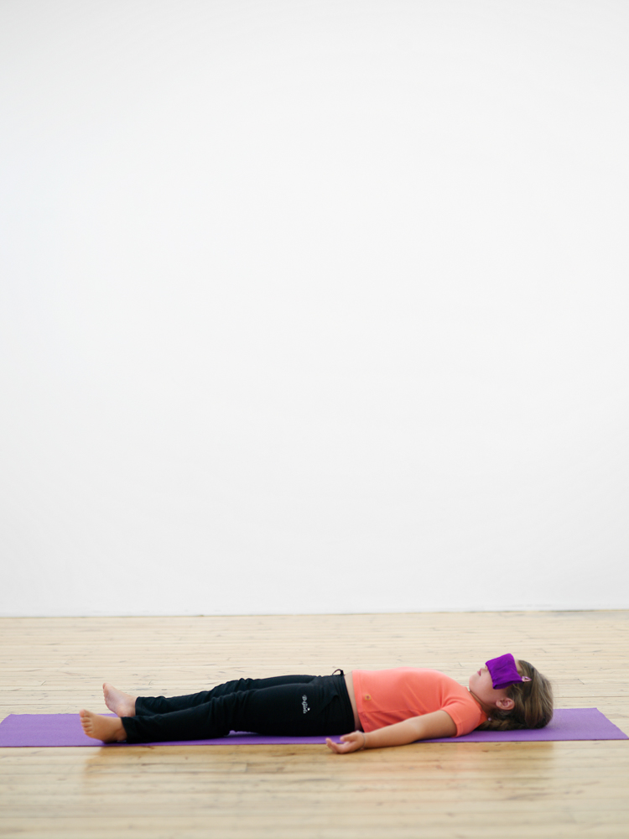
Do Nothing Doll / corpse (Savasana)
Roll onto your back and lie flat.
Make sure your spine is straight and look up at the ceiling.
Close your eyes.
Let your arms and legs flop onto the mat like a rag doll.
Feel the ground beneath you.
Imagine your mat/the floor is a piece of hot toast and you are a little ball of butter gently melting over the toast.

Slide 6
BALANCE & CONCENTRATION

Slide 7
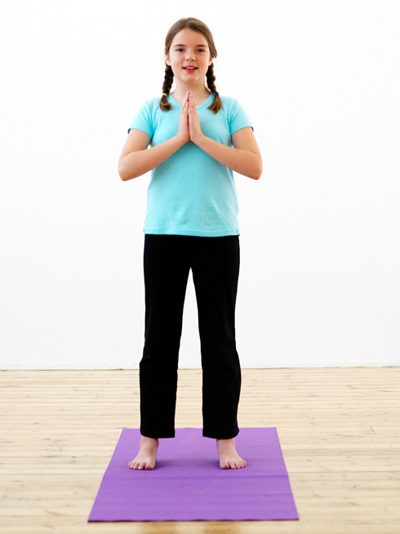
Mountain (Tadasana)
Stand with your feet hip distance apart.
Spread your toes out and imagine you have roots growing from your feet.
Imagine your weight dropping down your legs from your hips into the ground beneath you.
At the same time imagine your are being pulled up towards the sun by a golden thread attached to the crown of your head.
Breathe in and as you breath out bring your hands together in prayer position, gently pressing your palms together in the middle of your body.

Slide 8
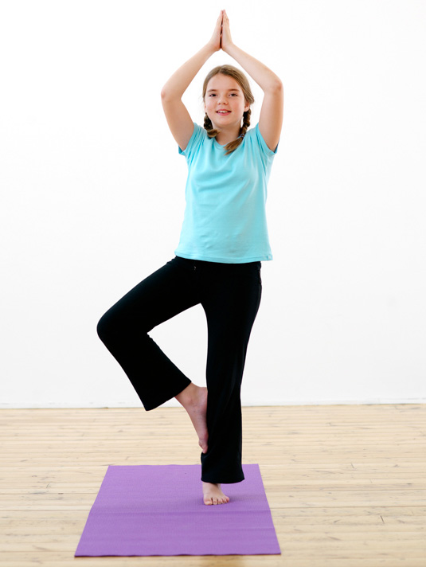
Tree (Vrkasana)
Take a deep breath in and as you breathe out let your left foot sink into the ground.
Gently lift the sole of the right foot and place it on your calf or your thigh.
Breathe in and as you breathe out slowly raise your hands up to the sky.
Place your right foot back on the mat and do the same on the other side.

Slide 9
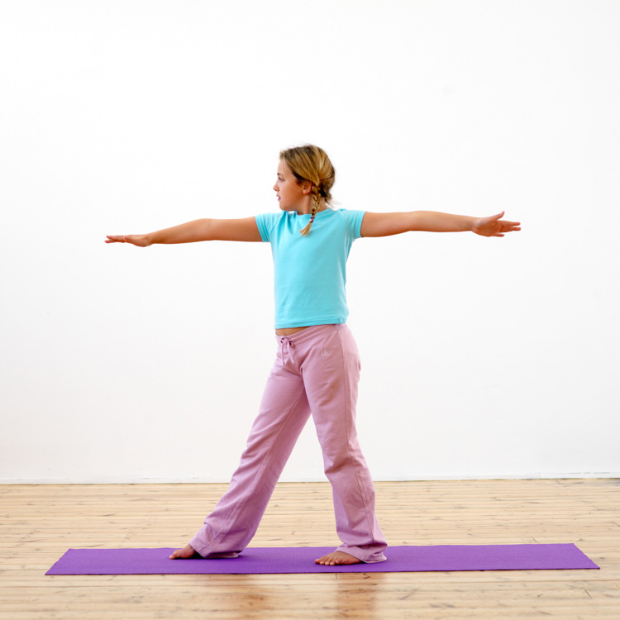
Warrior (Virabhadrasana)
Stand straight and tall with your feet hip distance apart and parallel.
Keep the left foot firmly planted on the ground take a giant step forward with your right foot, keeping the toes of both feet facing forward.
Keeping your feet firmly planted raise your arms to shoulder height with your right hand forward.
Extend your arms away from you and gaze beyond the middle finger of the right hand.

Slide 10
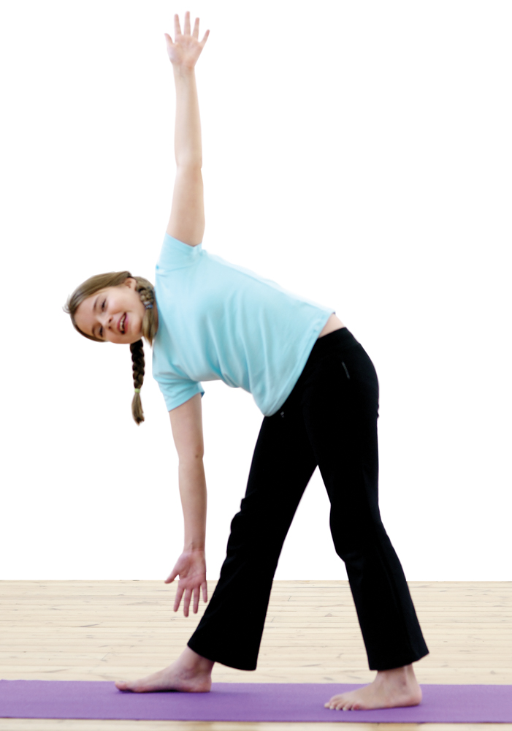
Triangle (Trikonasana)
From position 3, keep the back foot firmly on the mat and your hips facing forward.
Lengthen forward turning your head to the left.
Bend sideways dropping the right arm and taking the left arm up towards the ceiling.

Slide 11
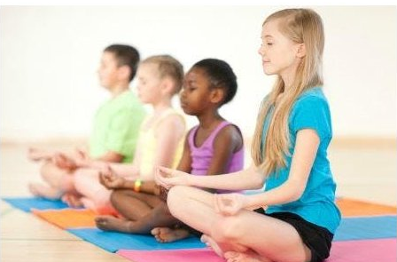
MEDITATION

Slide 12
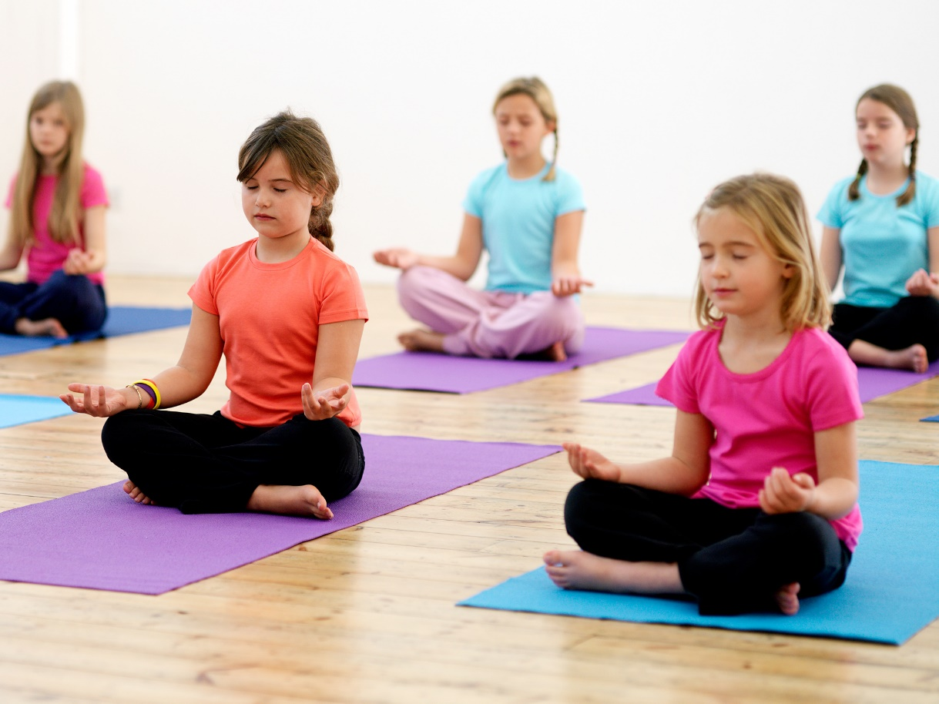
Sit cross-legged on the ground. Plant your sitting bones firmly on the ground and try and have your back straight and tall. Close your eyes and notice how you are breathing.
As you breathe in, imagine you are breathing in wonderful golden stardust that makes you feel warm and happy. As you breathe out, let go of any little niggles or worries.
Do this for three of four times.

Slide 13
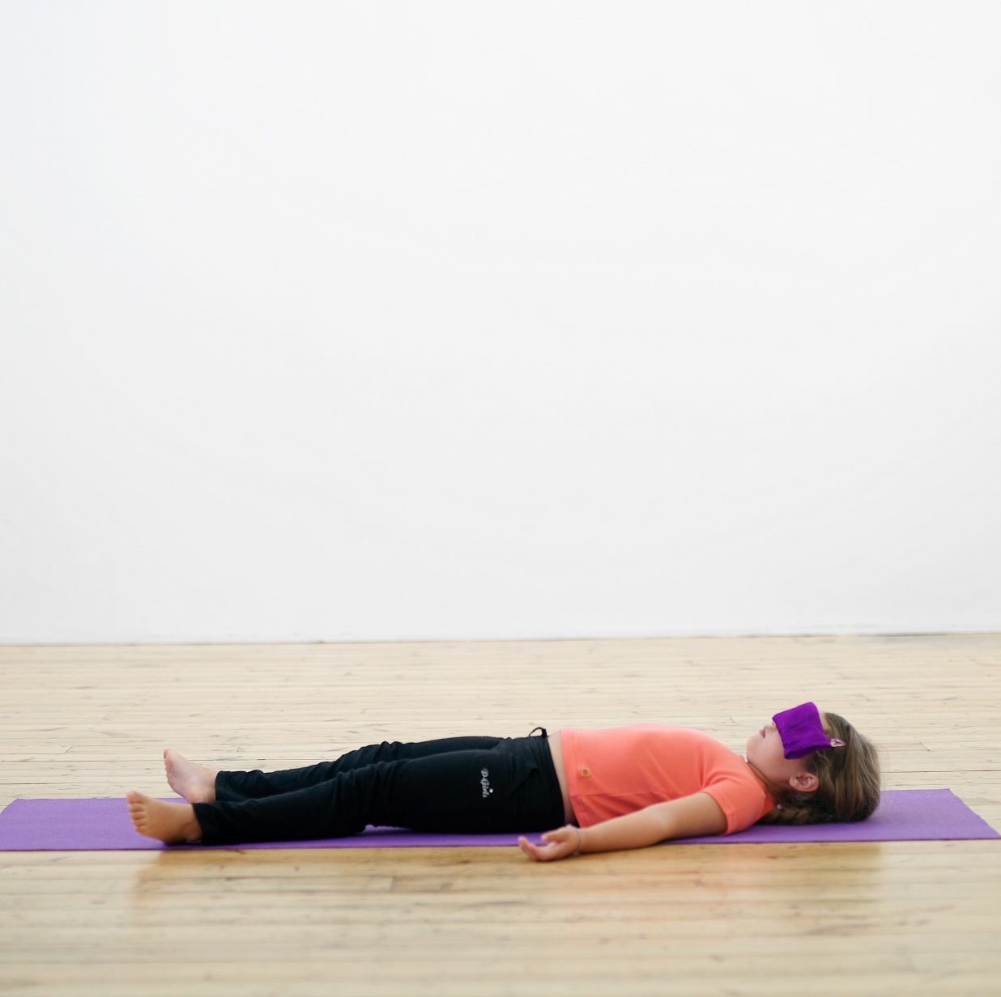
Lie on the floor with your legs long and your hands by your sides.
Close your eyes. Imagine it is a warm summer day and you are lying in the bottom of an open boat. The boat is gently rocking from side to side and you can feel the warm summer sun on your skin.
You hear birds singing and you can smell the perfume of roses as it catches in the soft summer breeze. Your boat slowly drifts downstream and you watch the blue sky above you. Little white clouds float along and you feel happy and relaxed.
Stay here for as long as you like drifting down the river. When you do decide to move take your time.

Slide 14

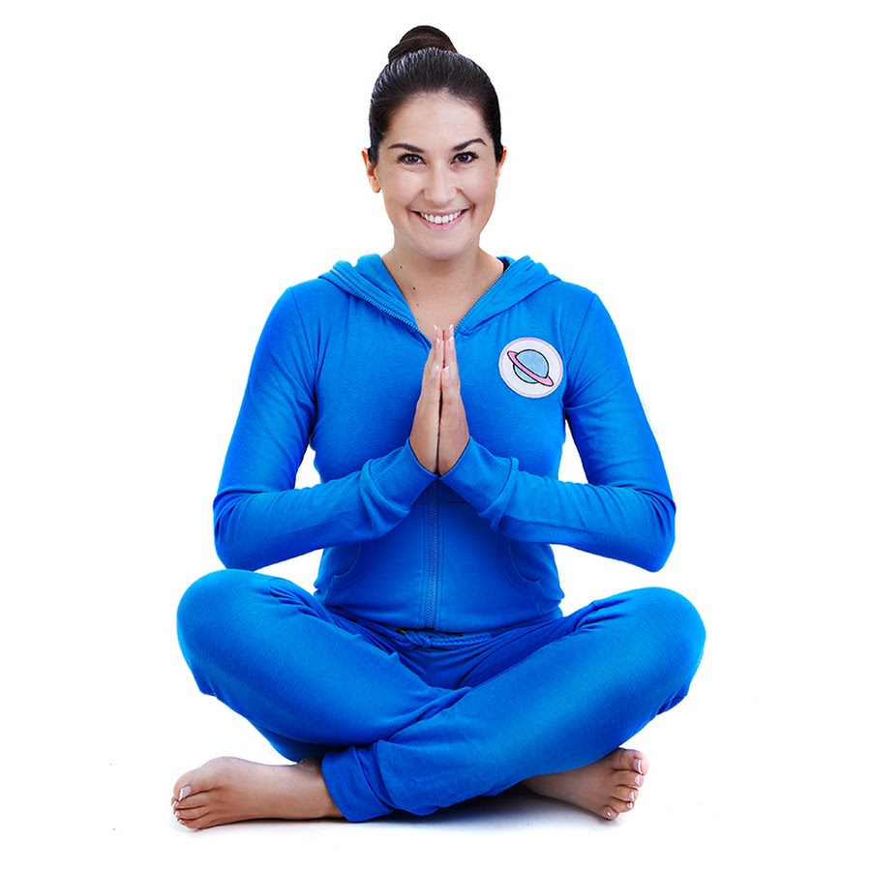
Internet link for interactive session:
Cosmic Kids: https://www.cosmickids.com/

